Slide 1

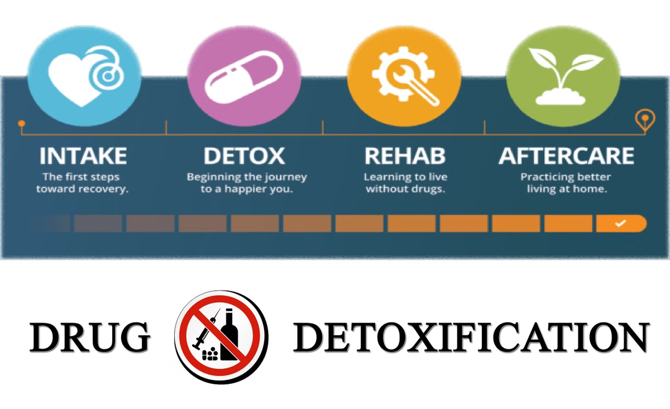
Lebone Ltd. Drug Detox & Recovery Center
We treat drug and alcohol withdrawal, providing a safe, comfortable detoxification.
LP
by Leonard Phokane

Slide 2
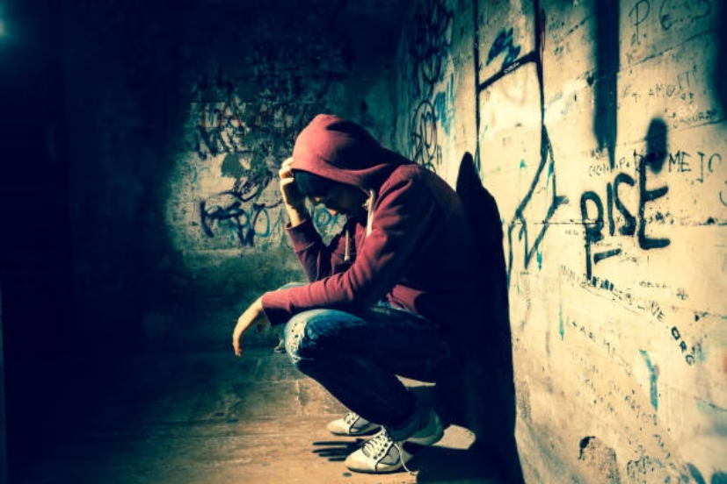
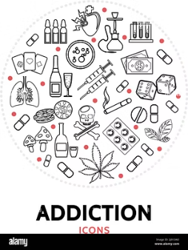
Problem
Drug Use amongst South African Youths. High school learners between 12 to 18 years in rural areas. Substances ever used Alcohol 32.7 % (223), Dagga 23.6 % (161), Cigarettes 10.3 % (70), Cocaine 9.1 % (62), Nyaope 2.8 % (19).
Notes:
The image on the left shows a man alone in a dark, empty space, conveying a sense of isolation and despair. The text on the right states "Alone in the dark", emphasizing the theme of loneliness and the challenges of navigating difficult, uncertain situations. This slide sets the stage for the presentation, introducing the audience to the central topic and the emotional experience being explored. I will use this slide to connect with the audience, inviting them to reflect on times when they've felt alone or lost in the darkness, and to consider how they've overcome such challenges.

Slide 3



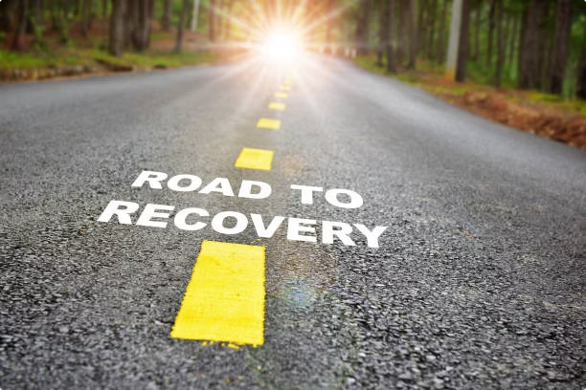
Solution
We treat drug and alcohol withdrawal, providing a safe, comfortable detoxification. So you can stay sober.
Lost in the darkness, embracing the solitude of darkness, engulfed by the night?
Get help from Lebone Ltd. Drug Detox & Recovery Center

Slide 4

Product
Safe & Comfortable Detoxification
Our center provides a medically supervised withdrawal process to ensure safety and comfort during detox.
Comprehensive Support Services
We offer counseling, therapy, and aftercare planning to support lasting sobriety and recovery.

Slide 5




Sales and Marketing Strategy
Venue Research
E-commerce website
Social media and online advertising
Promotion
Social media, email and radio ads
Approve site map
Stakeholder's approval

Slide 6
Target Market
Our primary target market consists of high school learners aged 12 to 18 years in rural areas of South Africa. This group is especially vulnerable to drug and alcohol use, with significant rates of consumption reported among them.
We also focus on families and community stakeholders who seek support and recovery services for their loved ones struggling with substance abuse.
Our outreach will prioritize these demographics using tailored communication channels to effectively reach and engage them.

Slide 7
Market Size
The drug and alcohol recovery market in South Africa, particularly in rural areas, represents a significant and growing opportunity. With high prevalence rates among youth aged 12 to 18 and increasing demand for safe detox services, the market size is estimated to encompass tens of thousands of potential clients annually. This demand highlights the urgent need for accessible and effective rehabilitation solutions.

Slide 8

Traction & Roadmap
Our journey begins with strong market traction and clear milestones ahead.
We aim to expand outreach, improve services, and scale recovery support efficiently.

Slide 9






Competitive Advantage
Expertise
Customized Care
Experienced staff specializing in safe, comfortable detox and recovery.
Individualized treatment plans tailored to each client’s unique needs.
Supportive Environment
Accessible Services
Warm, confidential setting promoting healing and long-term sobriety.
Convenient e-commerce platform and outreach through social media and radio.
24/7 Kitchen Access
Top Medical Staff
Unlimited Access to the kitchen Around the Clock!
Wellness Warriors who emphasize care and compassion
Always Open: Your Kitchen, Your Time

Slide 10
Competitors
Local Detox Centers
Online Recovery Programs
Private Rehabilitation Clinics
Many offer detox but lack personalized aftercare support.
Convenient but limited in hands-on medical supervision.
High cost limits accessibility for rural youth.

Slide 11
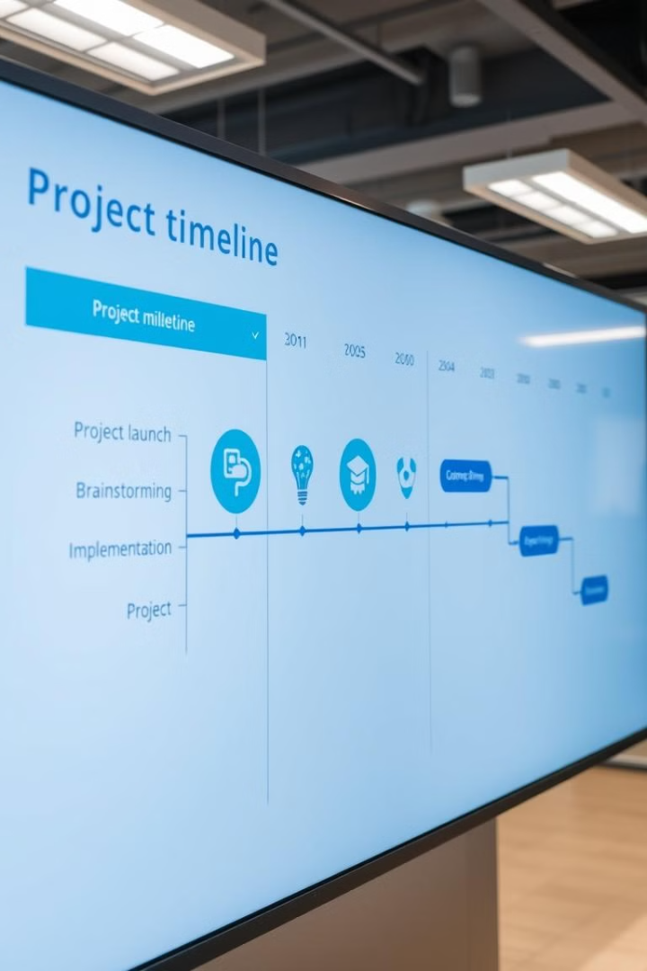
Milestones and Timeline
1
Approvals
Secure client and stakeholder approvals.
2
Meetings
Schedule important meetings and presentations.
3
Key Dates
Consider key dates or outages impacting timeline.

Slide 12
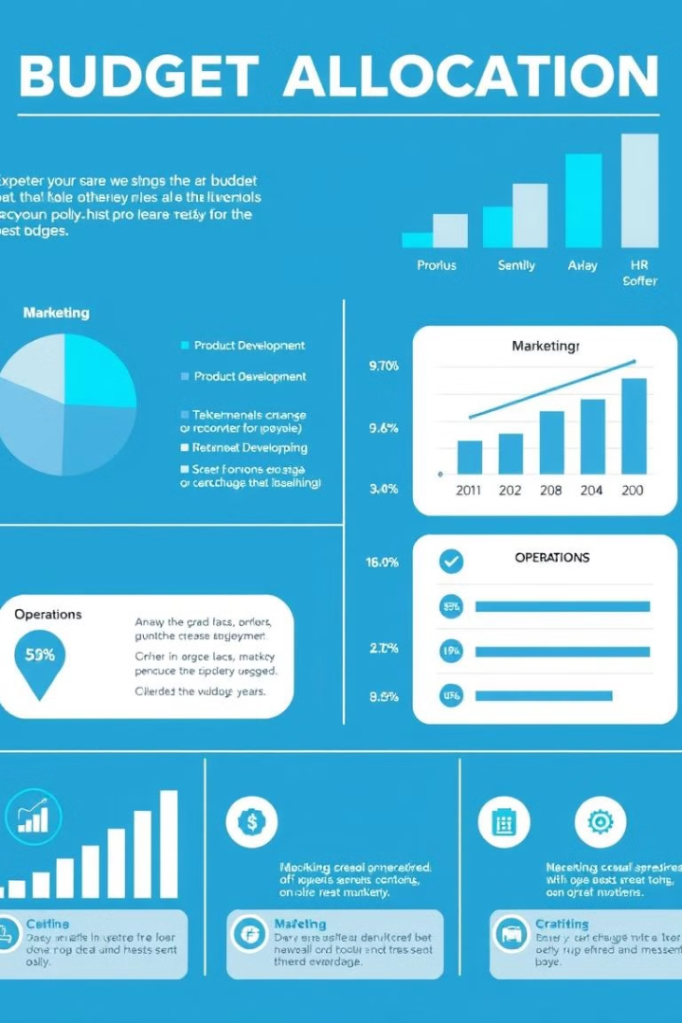
Budget Overview
100K
Setup Costs
Initial investments for equipment and premises.
180K
Running Costs
Ongoing expenses like rent and marketing.
500K
Total Costs
Combined setup and running costs.
2,5M
Income
Projected revenue from sales and services.

Slide 13
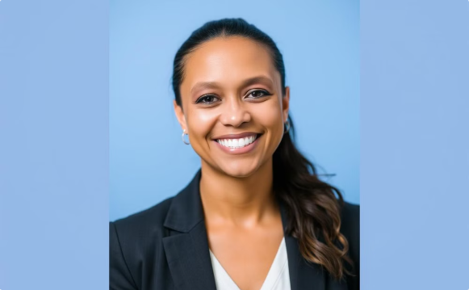
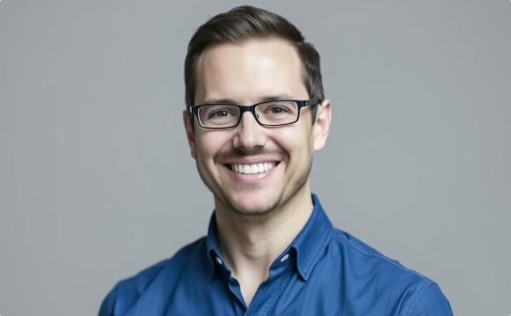
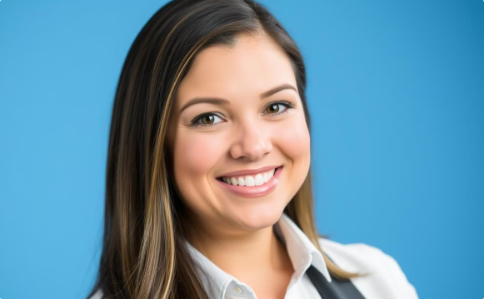
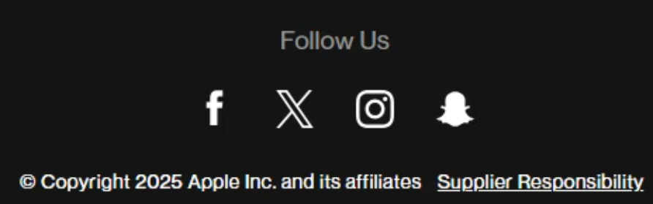
Meet the Team
Venessa Cameron
Dr. Mark Williams
Ms. Candice Anderson
Psychologist, psychiatric, and counselling expert
Doctor
Nurse
Our team brings diverse skills and experience to drive success. We are committed to delivering innovative solutions and exceeding expectations.

